Slide 1
Fast exact string matching algorithms
Thierry Lecroq
Information Processing Letters, Vol. 102, pp. 229–235, 2007
Date: July 18, 2007
Introducer: Chung-Han Chiang

Slide 2
Abstract
String matching is the problem of finding all the occurrences of a pattern in a text. We propose a very fast new family of string matching algorithms based on hashing q-grams. The new algorithms are the fastest on many cases, in particular, on small size alphabets.

Slide 3
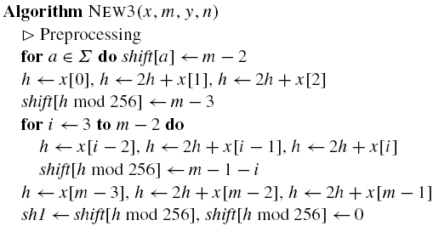
The new algorithm
Preprocessing:

Slide 4
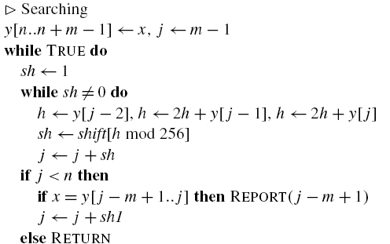
Searching:

Slide 5
Pattern=ACCTGACTGA , q = 3
Preprocessing
We can get substring B = ACC, CCT, CTG, TGA, GAC, ACT, CTG, TGA.
Suppose that A = 1, C = 2, T = 3, G = 4.
h(ACC) = 10 , h(CCT) = 15, h(CTG) = 18, h(TGA) = 21, h(GAC) = 20, h(ACT) = 11.
h(CCC) = 14, h(AAA) = 7.

Slide 6
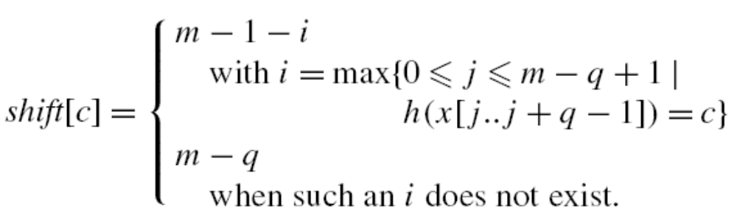
pattern= ACCTGACTGA
123456 78910
ACC = 10, j = 1 = i, ∴shift[10] = 10 – 1 – 1 = 8.
CTG = 18, i = max{ j = 3 or j = 7 }, ∴i = 7, ∴shift[18] = 10 – 1 – 7 = 2.
CCC = 14, ∴shift[14] = 10 – 3 = 7.

Slide 7
Searching
Suppose we want to know if ACC, CTG, CCC are in text ACCTGACTGA.
h(ACC) = 10, shift[h(ACC)] = 3
3 < n(=10), x = y[123] = ACC → found!
h(CTG) = 18, shift[h(CTG)] = 9
9 < n(=10), x = y[789] = CTG → found!
h(CCC) = 14, shift[h(CCC)] = 10
10 = n(=10) →not found!

Slide 8
Text = AATCGGCTAGCTCG
Patten₁ = AGCTCG
Patten₂ = TCGAAT
Patten₃ = GGCTAG
Patten₄ = TAGCTC
Substring B = {AGC, GCT, CTC, TCG, CGA, GAA, AAT, GGC, CTA, TAG, CTC}

Slide 9
Text = AATCGGCTAGCTCG
Patten₁ = AGCTCG, q = 3
AATCGGCTAGCTCG
AGCTCG
CGG不存在於P₁, 往後移q格
AATCGGCTAGCTCG
AGCTCG
CTA不存在於P₁, 往後移q格
AATCGGCTAGCTCG
AGCTCG
GCT存在於P₁, 將P₁GCT對齊Text
AATCGGCTAGCTCG
AGCTCG
TCG = TCG, 開始比對前面是否有match

Slide 10
CASE
AATCGGCTAGCTCG
AGCTCG
AATCGGCTATCGGTCGGCTACTAGCTCG
向後SHIFT一格
CTGCTAGC
CASE 1:
If p[1…m-3] ≠ t[i…i+m-4]
shift = 1
CASE 2:
If p[1…m-3] ＝ t[i…i+m-4]
match
AATCGGCTATCGGTCGGCTACTAGCTCG
CTACTAGC

Slide 11
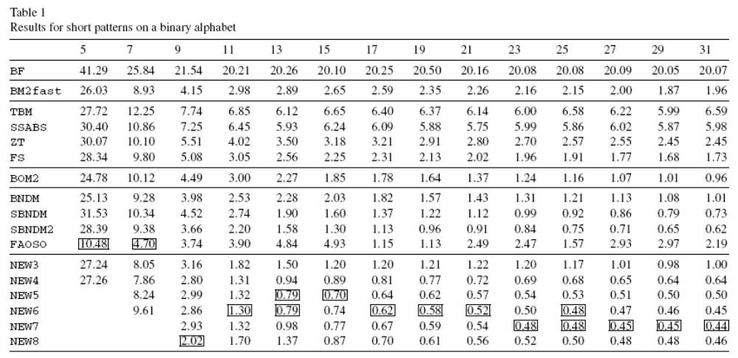
Result

Slide 12
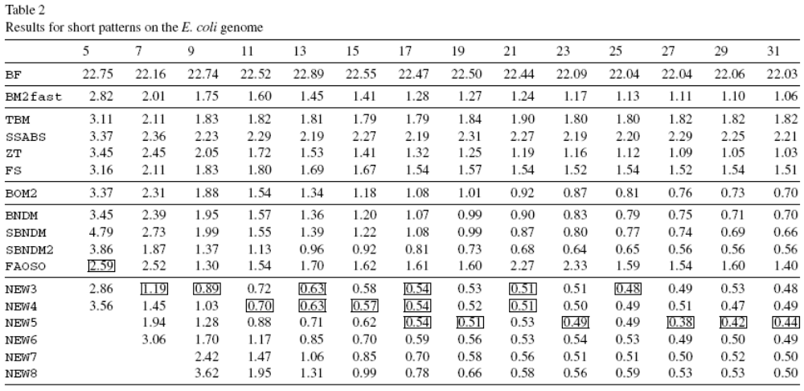

Slide 13
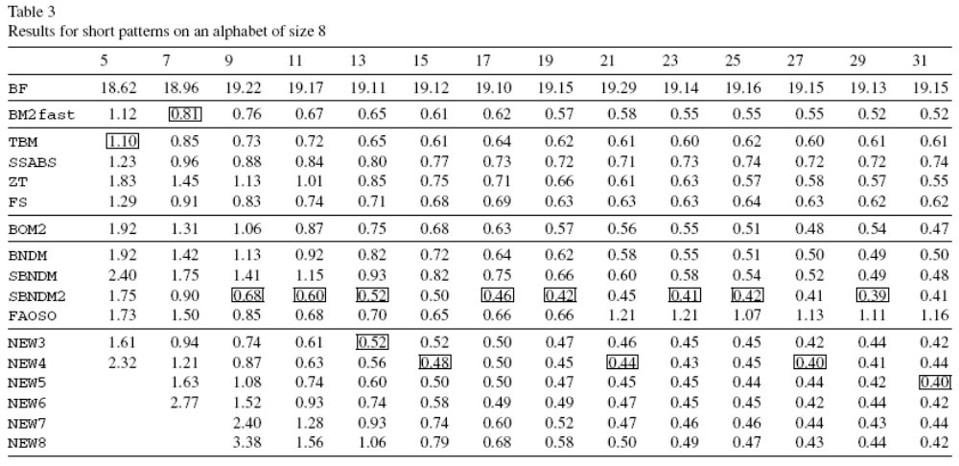

Slide 14
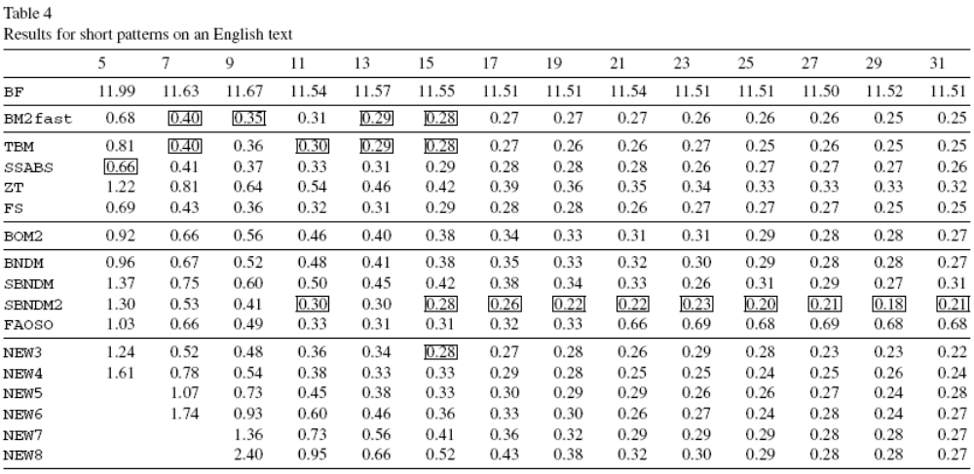

Slide 15
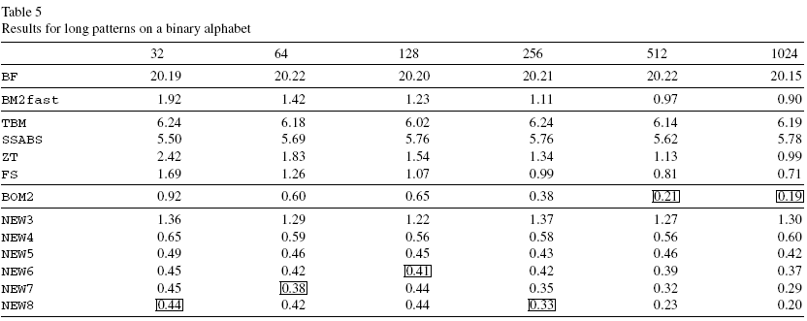

Slide 16
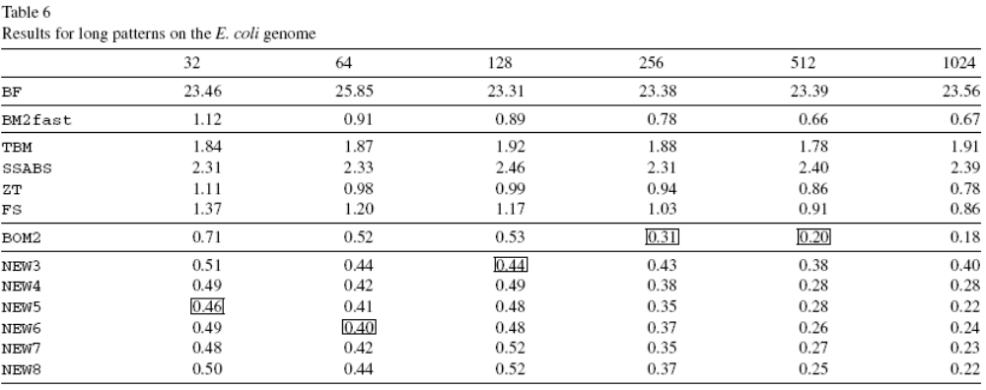

Slide 17
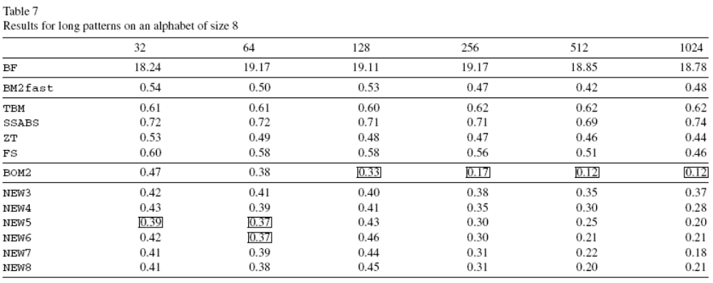

Slide 18
